Slide 1
Are you an optimist?
Engaging Learners with structured, tiered, and differentiated activities!

Slide 2
”I am enough of a realist to understand that I can’t reach every child, but I am more of an OPTIMIST to get up every morning and try.” Preston Morgan
Educator for 21 years
Appalachian State University Graduate
NBCT 2006
Master’s in Administration 2010 Grand Canyon University
Wife, Mother, Family Caregiver, Community Advocate
I Love Learning!

Slide 3
Engaging students in literature discussion
Key Considerations
Clear set rules and expectations
Explained, Modeled, and Practiced behaviors for activities
Focused specific tasks and activities
Feedback and Reflection
Notes:
At the beginning of the year I set clear expectations and rules. This rules for my classroom are taught and implemented and focused on for 2 weeks or more. I make students practice and repeat them until it becomes a habit. They should be able to teach and explain the rules to new students who enters the classroom. All task come with focused and specific directions that are explained, repeated, and typed an put onto the computer Canvass, work area, or tables. So if at anytime there is a question they can refer to this. I do give feedback and reflection on group work and indivdual work in the from of a rubirc. Please see the attached documents for grading on group work or individual tasks. If a class can not handle or has more difficulty with following rules of group work I do not allow this class to do as many group work activiites, or I only allow the students I know who can handle it to work together, others have to work alone or with me.

Slide 4
Four Corners Fun
Answer Documents are posted up around the Room into 4 Corners or 4 Areas
Students are put into small groups
Students are given a Reading Selection
Timer
Give Students Questions, they have 3-5 minutes to post answers on wall.
First group to get all questions correct and finished, wins a Prize!
Notes:
American Flag Heroine

Slide 5
Four Corners Sticky Notes
Look at the color sticky note or card you have.
Answer the questions for that color in your interactive notebook/paper
When teacher calls time you will go the corner of the room for you color sticky note or card and verbally respond together to your question.
Make sure you use evidence from the selection to support your answer.
Notes:
American Flag Heroine

Slide 6
Collaboration Rotation
Teacher has posted skill questions up around the room in 6 areas.
Students are given a number 1-6.
Students read the selection
Teacher makes announcement to move to numbered area and begin discussion of question posted for that area. Timer 3-5 minutes. Rotate.
Notes:
American Flag Heroine

Slide 7
Specific Tasks, Focused Skill Work, Differentiated

Slide 8
Author’s Purpose Practice
Example of Station Rotation
2 Stations of Practicing skills (sometimes stations are Tiered)
Stations include quick Anchor activity in case they finish practice before rotation
1 Station Teacher Directed with Tiered Activities
Independent Area -work on Skill work or Practice Games using Computer

Slide 9
Point of View Games
Guess the POV
https://www.quia.com/rr/665547.html Jeopardy https://www.quia.com/cb/721939.html
Point of View Pilothttp://ereadinggames.com/viewpoint-pilot/
POV Practice Game http://www.learningfarm.com/web/practicePassThrough.cfm?TopicID=10
POV Video https://learnzillion.com/lesson_plans/7524-determine-the-author-s-point-of-view-and-distinguish-it-from-your-own#lesson
POV Basketball Game
http://reviewgamezone.com/games/supershooter/index.php?2423&title=Point%20Of%20View
POV Practice Game
https://www.superteachertools.us/jeopardyx/jeopardy-review-game.php?gamefile=171403#.WKYje1e-qlI
Author’s Purpose Practice Test Tutor
http://www.harcourtschool.com/activity/trophies/test_tutor/grade4/skill1/important_day.html
Author’s View Practice 2 Test Tutor
http://www.harcourtschool.com/activity/trophies/test_tutor/grade3/skill1/crowded.html
POV It’s Your book
http://www.ereadingworksheets.com/point-of-view-worksheets/point-of-view-worksheet-15/

Slide 10
Chunking Reading for Discussion
Reading is Chunked
Good to use with more challenging selection or stories
Quick Reads of Paragraphs for Pause and Reflection
Analysis and to determine literary devices
Stop and Summarize
Determine Word Meaning
Opportunity to Discuss selection or story

Slide 11
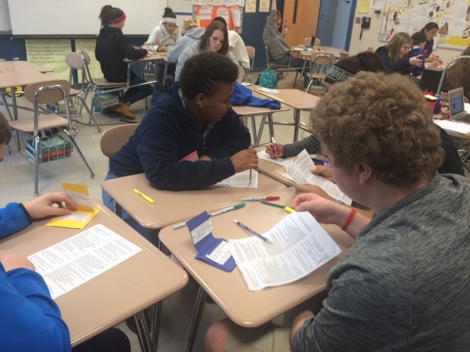
Poetry Analysis

Slide 12
Collaboration While Reading
Roll the Dice
RUNNERS/Reading Strategies
QARs

Slide 13
For more Intentional Collaboration
Socratic Seminar
Directed Reading Pause and Reflect Activity as Group

Slide 14
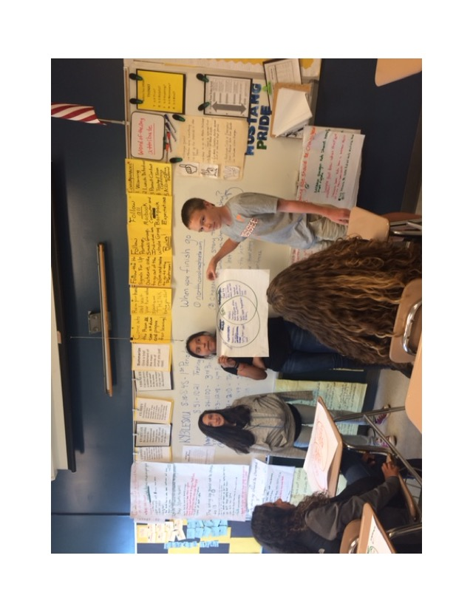
What did You find out?

Slide 15
Additional Movement Activities
Inside/Outside Circle
Soul Train Dance Line
Miss that Word, and do a Crazy Move
Actions to mimic the Vocabulary Meaning
Word Match (Using notecards students match a word, with meaning, synonym, antonym).

Slide 16
How Do You Get Students to Stay on Task and Focused?
Clear Expectations and Rules –Modeled and Explained
Consistency
Building Relationships
Feedback and Reflection
Graded Assessments

Slide 17
Contact Information
marlene_scott@iss.k12.nc.us
Website with additional resources located on the West Iredell Middle School, Our Staff, Marlene Scott
http://iss.schoolwires.com/Domain/5057

