Slide 1
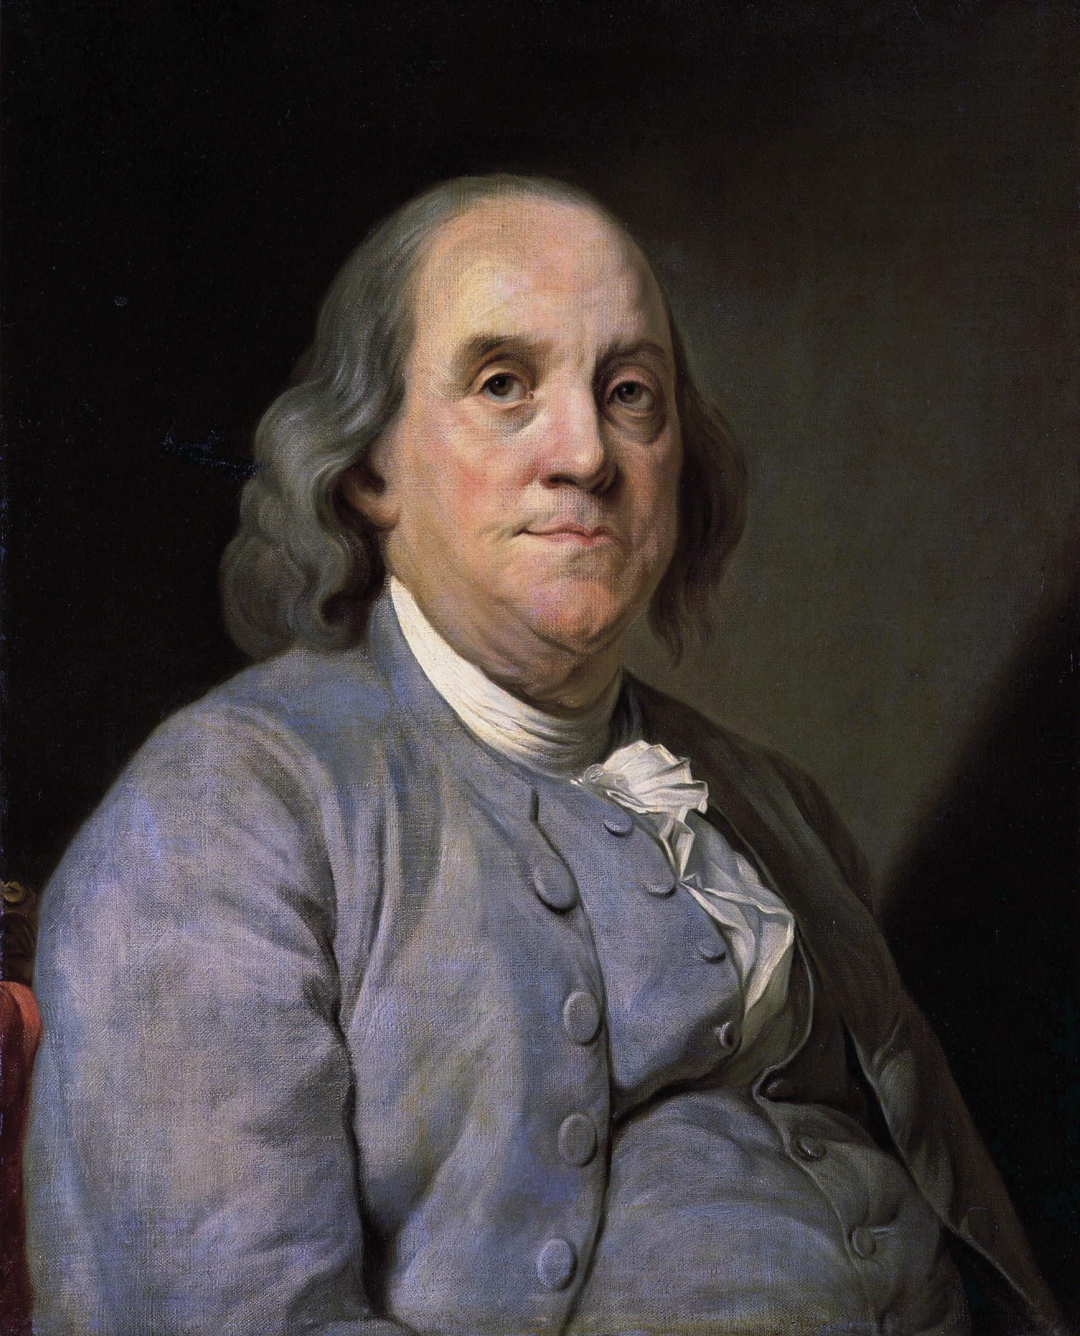
Bringing Benjamin Franklin into
the 21st Century Classroom:
Creating Leaders Using the 13 Virtues
Tamara E. Reynolds
NC Pre-K Mentor, EESLPD Office at UNC Charlotte (West)
Adjunct Faculty, Early Childhood Education Department
Asheville-Buncombe Technical Community College
Notes:
Photo credit: By Joseph Duplessis - http://www.npg.si.edu/exh/brush/ben.htm, Public Domain, https://commons.wikimedia.org/w/index.php?curid=52076
Tamara Reynolds – treyno24@uncc.edu or tamaraereynolds@abtech.edu

Slide 2
Rubric for Evaluating North Carolina Teachers
Standard I: Teachers Demonstrate Leadership
Element Ia. Teachers lead in their classrooms.
Element Ib. Teachers demonstrate leadership in the school.
Element Ic. Teachers lead the teaching profession.
Element Id. Teachers advocate for schools and students.
*Element Ie. Teachers demonstrate high ethical standards.
*Element Ie.Teachers demonstrate high ethical standards. Teachers demonstrate ethical principles including honesty, integrity, fair treatment, and respect for others. Teachers uphold the Code of Ethics for North Carolina Educators (effective June 1, 1997) and the Standards for Professional Conduct adopted April 1, 1998.
Notes:
North Carolina Teacher Evaluation Process
Rubric for Evaluating North Carolina Teachers
© 2009 McREL Developed in collaboration with the NC State Board of Education | Revised July 2015 http://www.dpi.state.nc.us/docs/effectiveness-model/ncees/teachers/individual/rubric.pdf

Slide 3
“Preamble: The purpose of this Code of Ethics is to define standards of professional conduct.
The responsibility to teach and the freedom to learn, and the guarantee of equal opportunity for all are essential to the achievement of these principles. The professional educator acknowledges the worth and dignity of every person and demonstrates the pursuit of truth and devotion to excellence, acquires knowledge, and nurtures democratic citizenship. The educator exemplifies a commitment to the teaching and learning processes with accountability to the students, maintains professional growth, exercises professional judgment, and personifies integrity. The educator strives to maintain the respect and confidence of colleagues, students, parents and legal guardians, and the community, and to serve as an appropriate role model.”
Notes:
North Carolina State Board of Education Policy Manual
Policy Title: 16 NCAC 6C .0601 and 16 NCAC 6C .0602 Policy regarding the Code of Ethics for North Carolina Educators
http://www.ncpublicschools.org/docs/effectiveness-model/ncees/standards/code-of-ethics.pdf

Slide 4
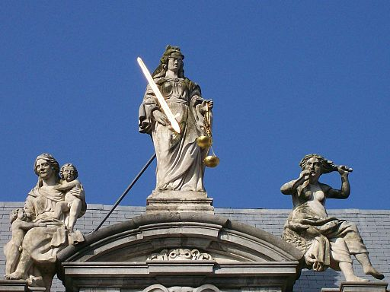
What is a virtue?
Notes:
By Tony Grist (Photographer's own files) [Public domain], via Wikimedia Commons
https://commons.wikimedia.org/wiki/File%3AJustice%2C_with_Virtue_and_Vice.jpg

Slide 5
Virtue (Latin: virtus, Ancient Greek: ἀρετή "arete") is moral excellence. A virtue is a trait or quality that is deemed to be morally good and thus is valued as a foundation of principle and good moral being. Personal virtues are characteristics valued as promoting collective and individual greatness. The opposite of virtue is vice.
Wikipedia
Notes:
Virtue. (2017, March 29). Retrieved March 30, 2017, from https://en.wikipedia.org/wiki/Virtue

Slide 6
Virtue 1. moral excellence; goodness; righteousness. 2. conformity of one's life and conduct to moral and ethical principles;uprightness; rectitude. 3. chastity; virginity: to lose one's virtue. 4. a particular moral excellence. Compare cardinal virtues, natural virtue, theological virtue. 5. a good or admirable quality or property: the virtue of knowing one's weaknesses. 6. effective force; power or potency: a charm with the virtue of removing warts.
Dictionary.com
Notes:
Virtue. (n.d.). Dictionary.com Unabridged. Retrieved March 30, 2017 from Dictionary.com website http://www.dictionary.com/browse/virtue

Slide 7
Benjamin Franklin’s Thirteen Virtues
These names of virtues, with their precepts, were:
1. TEMPERENCE
Eat not to dullness; drink not to elevation.
2. SILENCE
Speak not but what may benefit others or yourself; avoid trifling conversation.
3. ORDER
Let all your things have their places; let each part of your business have its time.
4. RESOLUTION
Resolve to perform what you ought; perform without fail what you resolve.
Notes:
Pages 64-65
Franklin, B. (1996). Autobiography of Benjamin Franklin. Mineola, NY: Dover Publications.

Slide 8
5. FRUGALITY
Make no expense but to do good to others or yourself; i. e., waste nothing.
6. INDUSTRY.
Lose no time; be always employ'd in something useful; cut off all unnecessary actions.
7. SINCERITY.
Use no hurtful deceit; think innocently and justly, and, if you speak, speak accordingly.
8. JUSTICE.
Wrong none by doing injuries, or omitting the benefits that are your duty.
9. MODERATION.
Avoid extremes; forbear resenting injuries so much as you think they deserve.
Notes:
Pages 64-65
Franklin, B. (1996). Autobiography of Benjamin Franklin. Mineola, NY: Dover Publications.

Slide 9
10. CLEANLINESS.
Tolerate no uncleanliness in body, cloaths, or habitation.
11. TRANQUILITY.
Be not disturbed at trifles, or at accidents common or unavoidable.
12. CHASTITY.
Rarely use venery but for health or offspring, never to dullness, weakness, or the injury of your own or another's peace or reputation.
13. HUMILITY.
Imitate Jesus and Socrates.
Notes:
Pages 64-65
Franklin, B. (1996). Autobiography of Benjamin Franklin. Mineola, NY: Dover Publications.

