Slide 1
HyperDocs
Making Teachers’ Lives Easier

Slide 2
Task
→ To investigate best practices in effective digital learning
→ To learn how to effectively facilitate a class of diverse learners using various methods

Slide 3
ENGAGE
Imagine…
In the latest staff meeting, your principal talked about how he wanted to see more small group instruction, more differentiation, more student directed learning, and more independent learning? And, oh, by the way, the administration will begin conducting weekly walkthroughs to look for these elements.
You ask yourself, “How will I do it all?!”

Slide 4
EXPLORE
Go here to share when you were most stressed out as a teacher! Click the plus sign in the lower right hand corner to leave a comment!
SHARE

Slide 5
EXPLORE
Explore the resources and then sum up the main idea in 10 words or less!
Resource | 10 Word Summary!
How HyperDocs Can Transform Your Teaching
The #HyperDoc Effect: 7 ways using HyperDocs has changed my classroom
The Real Hype Around HyperDocs

Slide 6
EXPLORE Explore different tools to include in hyperdocs
Digital Assessment Tools | Online Collaboration | Content Input
The Ultimate List - 65 Digital Tools and Apps to Support Formative Assessment Practices | Padlet → Online bulletin board where students can share resources → allows students to comment on each other’s work | EdPuzzle → A resource that allows you to add questions and voice overs to a video → Great way to add formative assessment and flip the classroom
Fantastic, Fast Formative Assessment Tools | Socrative → Students can add responses to a stream and provide feedback through voting | CommonLit → Leveled text to provide students with background knowledge → provides differentiation and reading comprehension questions
Google Drawings → A variety of ways to use Google Drawings as a digital assessment tool | FlipGrid → A platform for student discussion and response to teacher written prompts → Students can also provide feedback on the responses of others | NewsELA → Leveled text with reading comprehension questions → Includes primary sources, text sets, and speeches

Slide 7
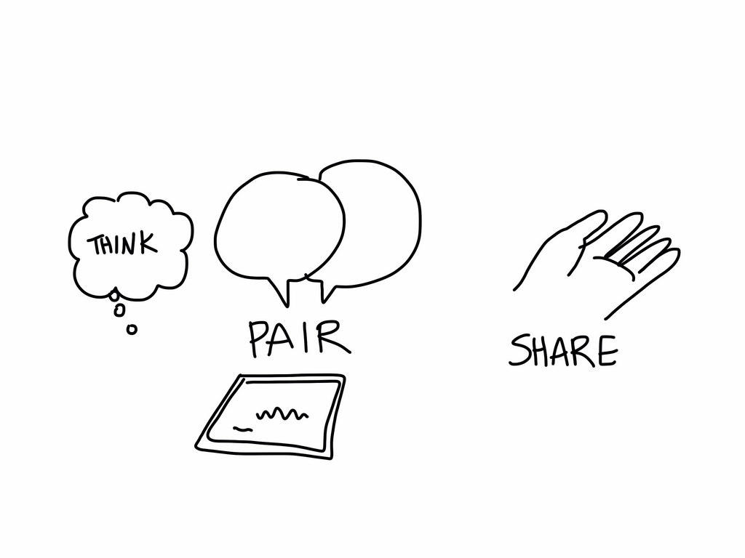
Share
What is a resource that you could foresee yourself using?
Share with a neighbor!

Slide 8
EXPLAIN
How are hyperdocs different from just a normal doc? <insert answer here>
What are some necessary components of hyperdocs?<insert answer here>
What could be some benefits of hyperdocs? Negatives? <insert answer here>
Listen to the following podcast: HYPERDOCS: HOW TO’S AND TIPS FOR TEACHERS
Use the transcript provided on the web page to follow along with the audion.
Answer the questions to the right.
Answer the questions in the text box!

Slide 9
Stop!
Take a sticky note and attach it to the chart paper answering this,
“How can hyperdocs help you in the classroom?”

Slide 10
Apply
Need some inspiration? Click here to find a wealth of teacher created examples!
Work with a partner if you’d like!
Go here to select a template for your own personal hyperdoc.
Think about the standards and the content that you teach!
Begin creating a hyperdoc that you could use for next year!
Post it to our session hyperdoc padlet!

Slide 11
Reflect and Share
Test your knowledge of hyperdocs against other conference attendees here!
Leave a reflection and watch others on our conference FlipGrid!

Slide 12
Extend
Click the links to learn more!
Books | Podcasts/ Webinars | Other
The HyperDoc Handbook: Digital Lesson Design Using Google Apps | How to Make Their Learning Go Viral | Interview with Karly Moura | The HyperDoc Website
Hacking Google for Education: 99 Ways to Leverage Google Tools in Classrooms, Schools, and Districts | Education on Air: What’s All the Hype about HyperDocs? | Shift the Way You Deliver Content With HyperDocs
Ditch That Textbook: Free Your Teaching and Revolutionize Your Classroom | HyperDocs- Lisa Highfill- CUE 2016 National Conference | Twitter Hashtags #HyperDocs #stealEDU #FileMakeACopy

Slide 13
Contact Info
Email: h.macdougall1986@gmail.com
Twitter Handle: @heather_macd

