Slide 1
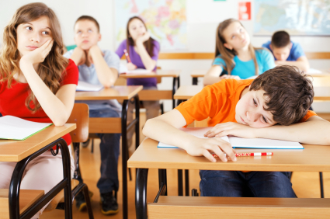
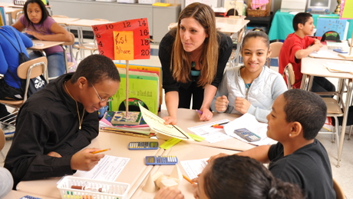
The dead has risen:
Classrooms revived from student engagement
Presented by: Mrs. S. Joyner, m.s.e

Slide 2
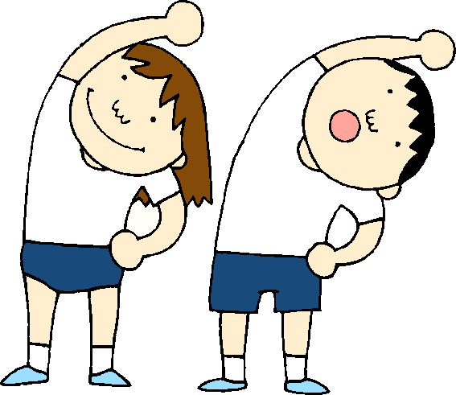
Be stubborn about your goals and & flexible about your methods!!!!!!!!!

Slide 3
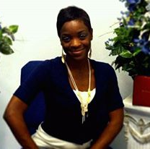
About me………
North Carolina Licensed Instructor Middle School/Secondary English Language & Literature
Nationally Trained Educational Consultant
M.A.S. (Secondary Education)
Doctoral Candidate E.D.D. Performance Improvement in Education

Slide 4
Today’s Agenda
Engaging icebreaker- common chains 10-MINUTES
Vote with your feet 20-minutes
Discuss requirements of voter with your feet-5 minutes
Hot seat- 5minutes
Create vote with your feet and hot seat questions with colleagues- 5 minutes
Questions/answers & Dismissal -5 minutes

Slide 5
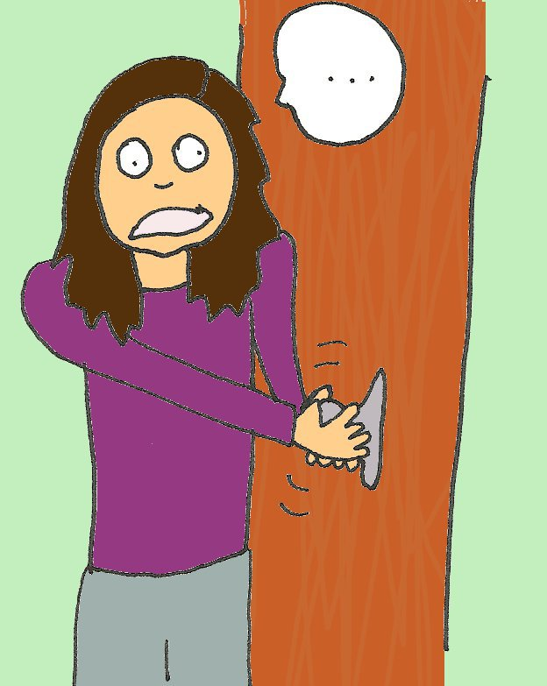
After a long day of teaching, you decide to offer tutoring. ONLY ONE STUDENT TOOK YOU UP ON THE OFFER AND DECIDED TO STAY. HOWEVER, THE JANITOR LOCKS THE DOOR IN HASTE AND YOU ARE TRAPPED INSIDE THE SCHOOL. Your phone is at home and all school phone lines are unavailable due to recent construction. HOW DO YOU SURVIVE UNTIL TOMORROW - knowing your class is on the 5th floor? Choose one superhero to rescue you!
Corner 1- batman
Corner 2- spiderman
corner 3- hulk
Corner 4-superman
(follow instructions of facilitator in regards to discussion and moving

Slide 6
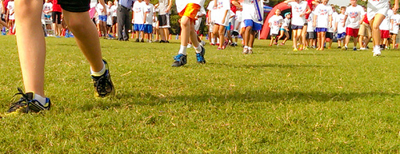
You just engaged in voting with your feet!
Appropriate for reviewing new and old content in all subject areas!

Slide 7
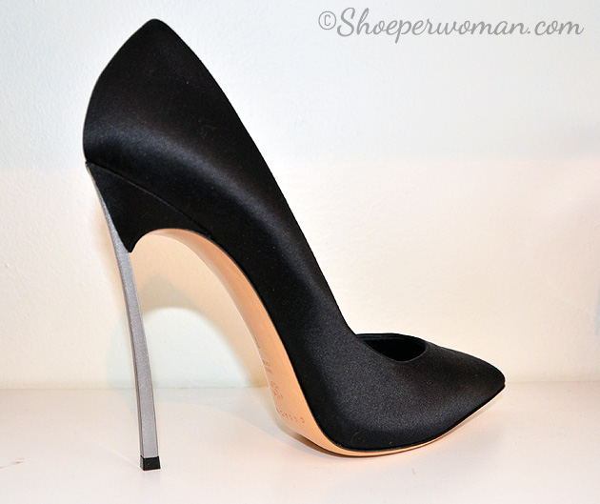
Vote with your feet!!!
Position and movement
Decisions and discussion
Divide and conqueror – both sides vote a representative to speak for them. Both sides speak and there is an opportunity for students to re-select their sides.
Human Graphs
Age or dates
Height
Preferences or talents

Slide 8
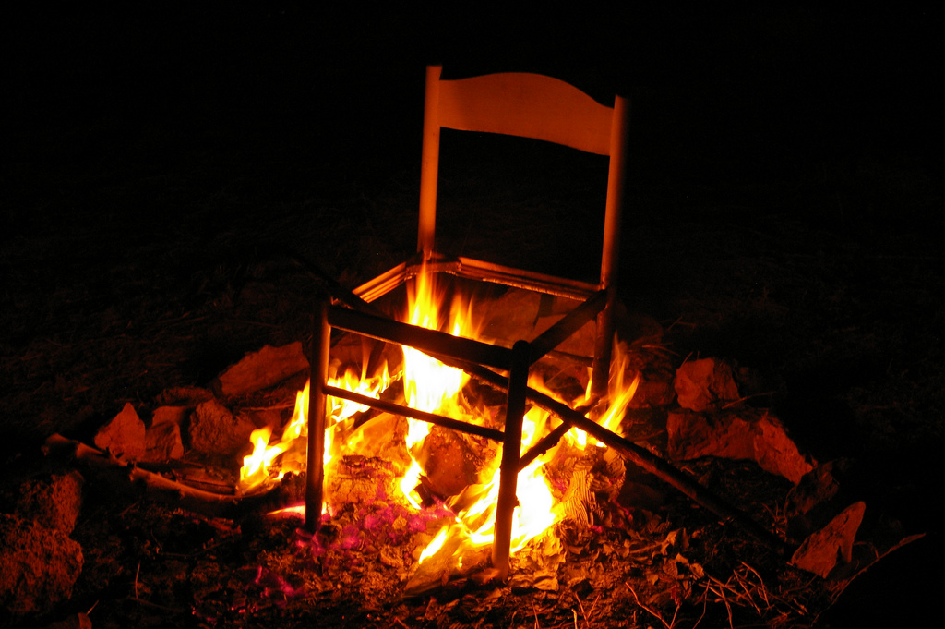
Hot seat!!!!!!!!!!
Dynamic Tension and teamwork
A single person has the responsibility of answering
Limited resources that build, or can be called upon (think Who Wants to be a Millionaire?”)
The person in the seat MUST be the one to answer, all others whisper their inputs to them.

Slide 9
How will students remain alive?
Avoid redundancy
Be versatile
Consider their input
Practice what you teach!!!!! Model the excitement…. And………………………..

Slide 10
RESET YOUR MIND!!!!!!!!!!!

