Slide 1
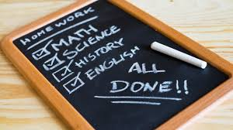
The Great Debate:
Alternatives to Homework
Presented by: Kelly Brock and Carrie Honeycutt, Stanly County Schools

Slide 2
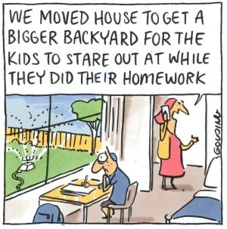
Things that
make you
go….
HUMMMM!

Slide 3
Session Goals:
Defining DEBATE
Analyze Research
Explore Alternate Ideas
HW Sort
Discuss Take-Aways

Slide 4
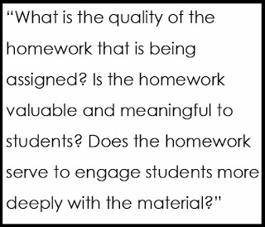
Defining the debate
Traditional or Non-traditional
For or Against
THIS NOT THAT

Slide 5
Analyze Research
Debate has been around a long time. Support for or against has varied throughout decades.
Recent research shows support for both sides.
Quality vs quantity of homework
Homework that benefits or is busy work?
Homework can teach more than content…time management, responsibility.
Teachers within same school or district vary in their opinion.
So…is there a way we can satisfy both sides of the debate?

Slide 6
Alternate ideas for homework
Refer to handout for thousands of ideas.
Think about your topic. What can students do at home that can reinforce idea?
Can they easily integrate into their afternoon routine?
Does it require easily accessible materials?
What task can others help with?
Is this “natural or normal” for them…hidden learning?
What can we do with it later (tomorrow, next week, as an adult)?
Does this topic even need to be reinforced?
Lets examine one alternate idea…cooking.

Slide 7
It’s your turn to use your noodle!
Read the HW assignment cards. Discuss with your group and sort them into the Venn Diagram. Use the notecard to create an example of your own for Traditional and Non-traditional.

Slide 8
Questions or comments?
You can contact us at:
Kelly.brock@stanlycountyschools.org
Carrie.honeycutt@stanlycountyschools.org

