Slide 1
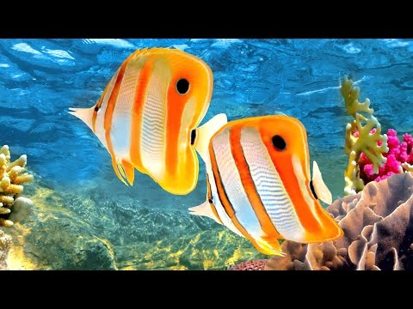
Notes:
Should start when walking in

Slide 2
The REAL Active Engagement of Language Arts
Melanie Jolley & Sandra King
Go to joinpd.com
Our join code is on the board
Notes:
BreAnn directions for Pear Deck
Mel for introductions - explain: have a lense for their grade level, they will receive the powerpoint with resources, we will treat them as a 5th grade class

Slide 3
Notes:
Mel- explain essential question

Slide 4
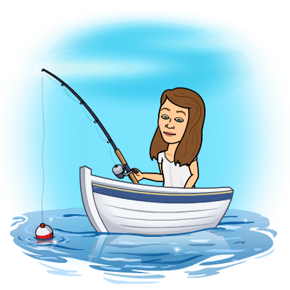
Notes:
Mel- task

Slide 5
Notes:
Mel- task

Slide 6
Notes:
Mel- task

Slide 7
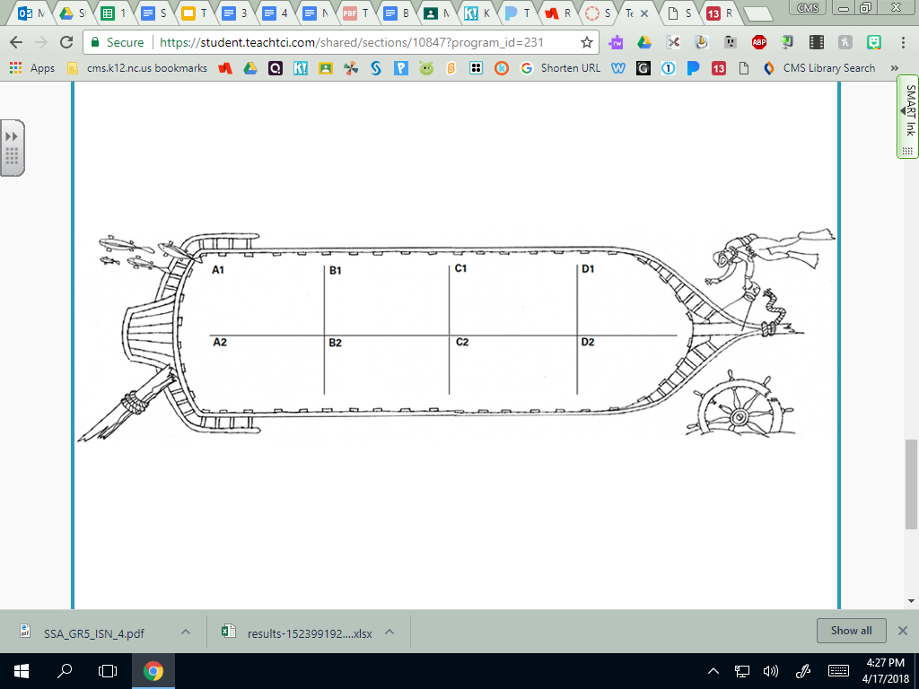
Notes:
🍐 This is a Pear Deck Draggable™ Slide.
🍐 To edit the type of question, go back to the "Ask Students a Question" in the Pear Deck sidebar.

Slide 8
Notes:
BreAnn- task, begin the dive

Slide 9
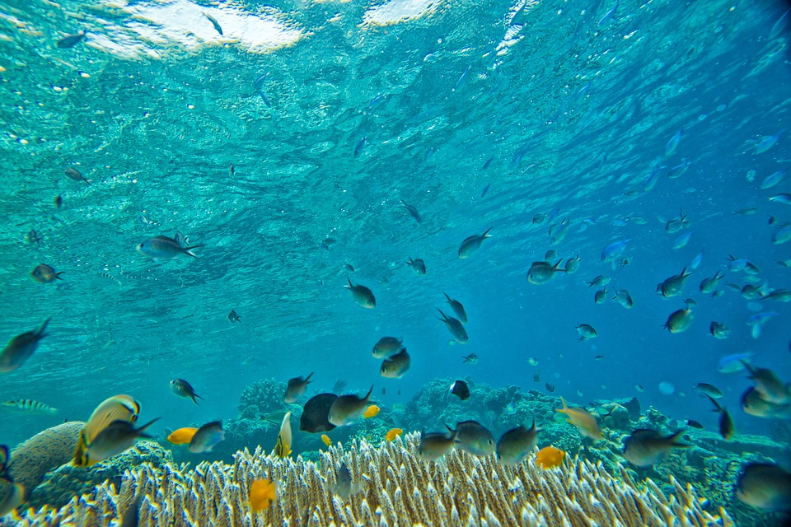
The (insert artifact/object name here) was important to explorers because...
Notes:
🍐 This is a Pear Deck Text Slide
🍐 To edit the type of question, go back to the "Ask Students a Question" in the Pear Deck sidebar.

Slide 10
Stand up, hands up, pair up!
Notes:
Mel

Slide 11
Notes:
Dive time! Turn on student self-paced.

Slide 12
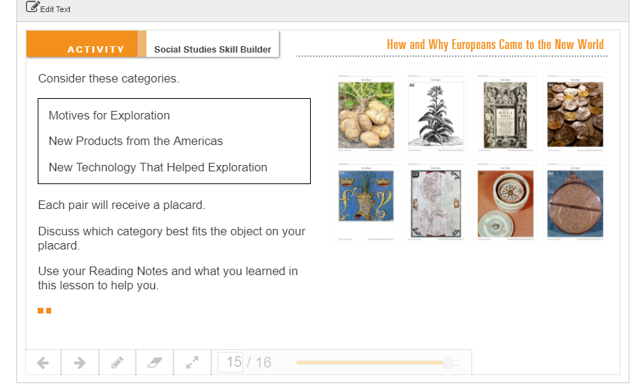
Notes:
Jolley

Slide 13
Standards We Covered
RI 5.2, RI 5.3, RI 5.4, RI 5.8, RI 5.10,
RF 5.5A, RF 5.5C
L 5.1, L 5.2, L 5.4, L 5.6
SL 5.1, SL 5.4,
W 5.2, W 5.3
Notes:
King

Slide 14
Outcomes
Notes:
king

Slide 15
By the end of today, you should be able to...
Integrate Reading and Social Studies units
Embed PBL activities into your lessons
Discover a new literacy block framework
Interact with strategies to increase student engagement using technology
Walk away with lessons you can implement in your classroom
Notes:
king

Slide 16
What does reading look like in your classroom?
Notes:
🍐 This is a Pear Deck Text Slide
🍐 To edit the type of question, go back to the "Ask Students a Question" in the Pear Deck sidebar.
King

Slide 17
How Do We Connect With Our Hard-to-Reach Scholars?
Connect student’s culture and background knowledge to the content using a holistic approach
Integrate Social Studies and technology within Reading
Use the “I do, We do, You do” structure for our lessons, differentiating based on students needs
Structured family community (praise and consequences)
PASSION!
Notes:
BreAnn up to I Do, We Do, You Do
Mel- rest of slide

Slide 18
Behind the Scenes
Look at large Social Studies themes and plan ELA curriculum around those.
Embedding test prep into all lessons by using Close Reading and Guided Reading strategies with passages.
Integrating Fiction and Non-Fiction simultaneously.
Use of technology throughout every aspect of class.
Notes:
BreAnn- goals
Mel LIGHTS

Slide 19
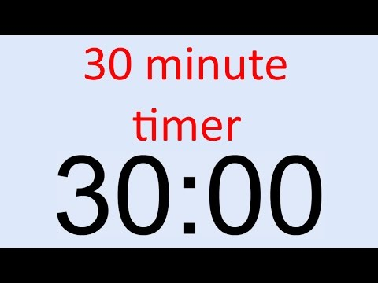
May Do:
Must Do:
Knights & Hornets
With your partner, Read Ch. 4: How and Why Europeans Came to the New World & complete Interactive Student Notebook & Interactive Tutorial
Book of Knowledge (on Readworks), choose one text from the set
Food & Farming
Quizlet, Chapter 4 (for 15 mins)
Knights & Hornets
Work on Explorer Project
TCI Ch. 4 Lesson Game
Edgenuity
Quizlet, MAP 201-210 (for 10 minutes)
Panthers & Checkers
With your partner, Read Ch. 4: How and Why Europeans Came to the New World & complete Interactive Student Notebook & Interactive Tutorial
Book of Knowledge (on Readworks), choose one text from the set
Food & Farming
Quizlet, , Chapter 4 (for 15 mins)
Panthers & Checkers
Work on Explorer Project
TCI, Lesson 4, Choose Any 1 Section (below Summary) to complete
Read & complete Interactive Student Notebook
Read a book, looking for Contrasts/Contradictions, Aha Moments, Tough Questions, Words to the Wiser, & Again and Again
Quizlet, MAP 221-230 (for 10 minutes)
Notes:
Mel- explain Must Do
BreAnn- May Do

Slide 20
Article of the Day (on NewsELA): Discovery of Bronze Arm Intensifies Ocean Search for More Sculptures
Knights & Hornets: Lexile 820
Panthers & Checkers: Lexile 1020
*Students will then compete in a game of Kahoot!
Notes:
BreAnn

Slide 21
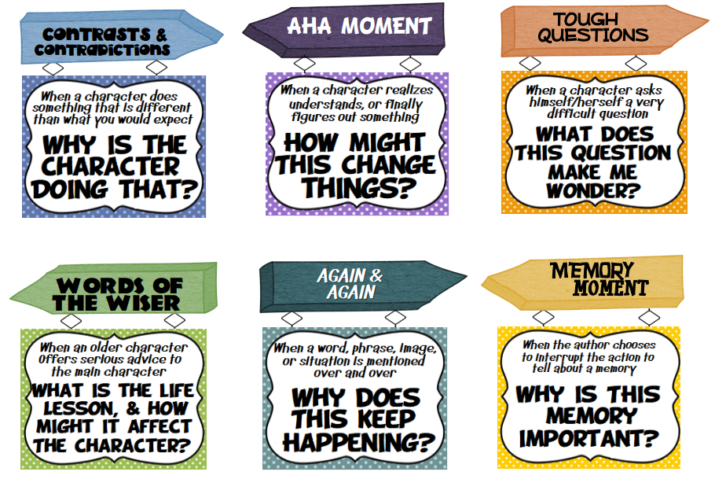
Notice and Note, Kylene Beers and Robert E. Probst
Notes:
King

Slide 22
Breakout Session:
Notice and Note
Paideia Seminars

Slide 23
Paideia Seminar
What is the purpose?

Slide 24
Gain a better understanding of your own ideas and values
Understand the relationship between dialogue and thinking
Build community

Slide 25
A Paideia Seminar is a collaborative, intellectual dialogue about text, facilitated with open-ended questions. The main purpose of seminar is to arrive at a fuller understanding of the textual ideas and values, of ourselves, and of each other.

Slide 26
Facilitator vs Participants
Asking challenging, open-ended questions
Take a variety of notes to keep up with the talk turns and flow of ideas
Help move the discussion along in a productive direction by asking follow-up questions based on my notes
Think, listen, and speak candidly about your thoughts, reactions, and ideas.
Use each other’s names
Discussion is collaborative in that you try to stay focused on the main speaker and wait your turn to talk (you do not need to raise your hand)
Both agree and disagree in a courteous, thoughtful manner, focusing on the ideas involved, not the individuals

Slide 27
Personal Goal Setting
Reflect on how you normally participate in a discussion a a group. What goal can you set for yourself that will help the flow and meaning of the seminar?

Slide 28
Please Consider the List of Personal Goals:
To speak at least 3 times
To refer to the text
To ask a question
To build on other’s ideas
Is there one that is relevant for you? Please choose one goal from the list or that you feel is best and commit to achieving it during the discussion.

Slide 29
For this seminar, I will suggest our group goal:
TO BUILD ON OTHERS COMMENTS

Slide 30
Lincoln’s Last Warning
Paideia Seminar

Slide 31
Ideas & Values:
Slavery
Civil War
Perspective

Slide 32
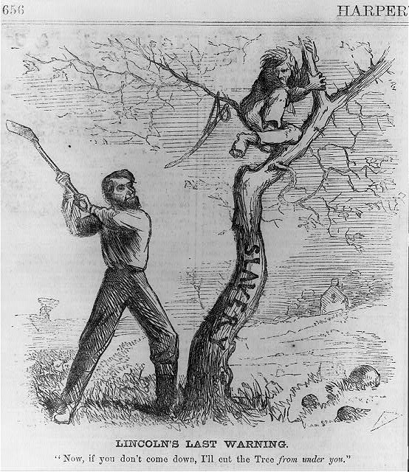
Notes:
2 seconds, 5 seconds, 7 seconds, 10 seconds - SW jot down what they saw, questions they may have. After viewing for 10 seconds TW zoom in on various parts of the picture.

Slide 33
Background Information:
It appeared in the magazine, Harper’s Weekly (October, 1862), which was published in New York.
The artist was Frank Bellew.

Slide 34
Pre Seminar
Define and state purpose for Paideia Seminar
Describe the responsibilities of facilitator and participants
Have participants set a personal goal
Agree on a group goal

Slide 35
Opening:
What stands out to you most?
Notes:
Round robin

Slide 36
Who would like to explain his/her answer and explain why?

Slide 37
Core:
Who are the two men in the image and what do they represent?

Slide 38
How do the facial expressions and body stature of the men show their power?

Slide 39
Explain the title, “Lincoln’s Last Warning.”
What is the significance of this title?
What does is mean?

Slide 40
Looking at the quote, “Now, if you don’t come down, I’ll cut the Tree from under you.”
What does this quote mean to you?
Why is the word, Tree, capitalized?

Slide 41
Do you think the illustrator was for or against slavery?
What elements from the sketch supports this?

Slide 42
Closing:
If you were the artist, what would you add to the cartoon?
Notes:
Round robin

Slide 43
Post-Seminar
Have participants do a written self-assessment of their personal participation goal
Do a group assessment of the social and intellectual goals of seminar
Note reminders for next seminar

Slide 44
Ideas & Values:
Slavery
Civil War
Perspective

Slide 45
Your Turn!
Create your own political cartoon that depicts your understanding of the Civil War from the perspectives of the North, South, or border states.

Slide 46
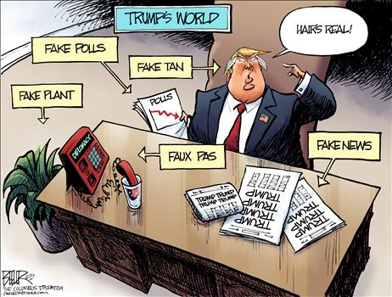

Slide 47
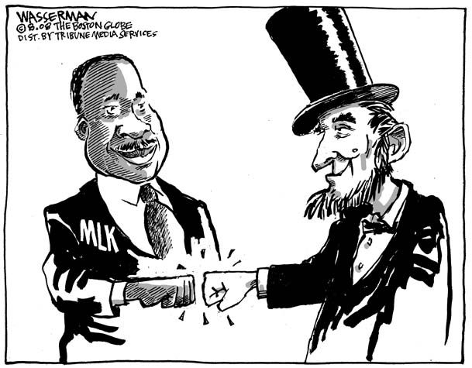

Slide 48
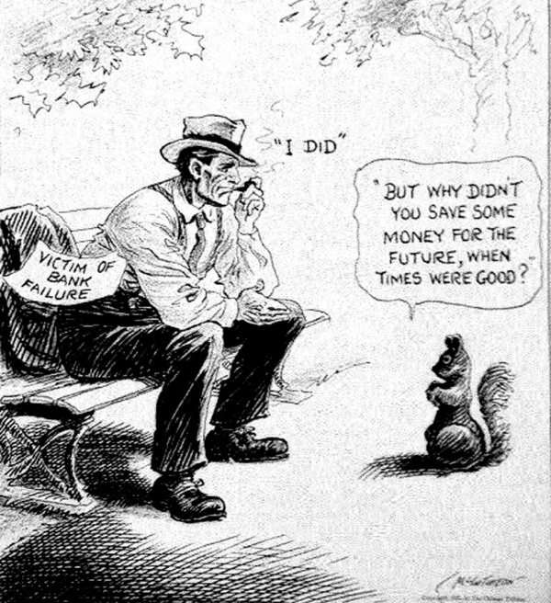
Notes:
The Great Depression

Slide 49
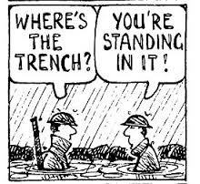
Notes:
World War 1

Slide 50
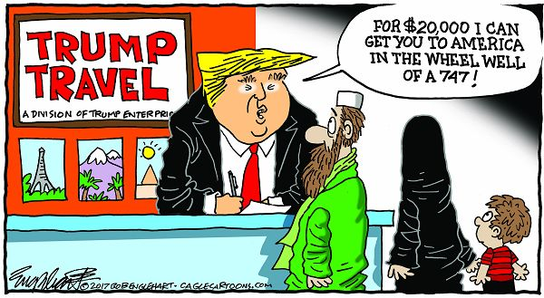

Slide 51
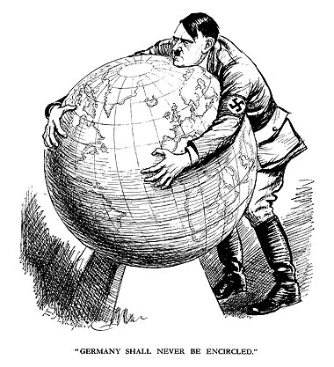
Notes:
WW2

Slide 52
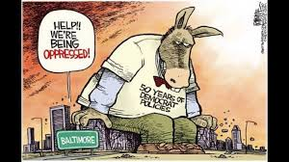
Notes:
Black Lives Matter

Slide 53
Create your own political cartoon that depicts your understanding of the Civil War from the perspectives of the North, South, or border states.
Must Include:
title, caption, symbolism
Shows, or Represents

Slide 54
Political cartoons aim to illustrate a certain issue and represent a viewpoint regarding it.
Political cartoons generally make use of simple artwork to get their point across quickly and cleanly.
Most political cartoons aim to illustrate perceived problems or defend political positions.

Slide 55
Create Your Own Political Cartoon!
Consider the issue you want to cover in your cartoon.
Think of what you want to say about the issue.
Imagine how you might represent the issue in your cartoon.
Consider what symbolism you want to include. A common technique that political cartoons make use of is symbolism.
*Symbols are images that represent larger ideas.
Label elements in your comic. Try including labels on figures or things that might otherwise be unclear as to what they represent. Label only important aspects in your comic.
Make use of analogies. An analogy is used to relate one concept to another. Consider using analogies in your comic to help your readers see the issue from another perspective.

Slide 56
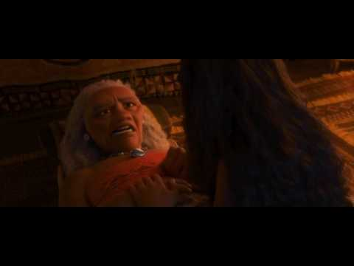
Words of the Wiser
What is the life lesson and how may it affect the character?
Notes:
King- give background of movie

Slide 57
I Do
Notes:
Point out that you noticed, “The writer made a scene where the main character is alone with an older character. This tells me that there may be a theme coming or a words of the wiser.”

Slide 58
We Do & You Do
Notes:
🍐 This is a Pear Deck Text Slide
🍐 To edit the type of question, go back to the "Ask Students a Question" in the Pear Deck sidebar.
Hand out bookmarks
“For today’s sake, we skipped the “I do” with the text but normally we do that before they work with partners. We show them where to put the WW in the text.”

Slide 59
Notice and Note Lesson Exemplars, 3rd Grade
Use of Making Meaning kits
Lesson plan examples
bit.ly/3GNoticeNote

Slide 60
Island of the Blue Dolphins
Scott O’Dell
Notes:
Mel- example

Slide 61
Chapter 1

Slide 62
Before We Read...
Putting your trust in someone (especially a friend) can be a dangerous thing to do, especially if that person lets you down.
Describe a time in your own life (or that of someone you know) when you felt let down by someone you trusted.
Turn and Talk
Notes:
Mel

Slide 63
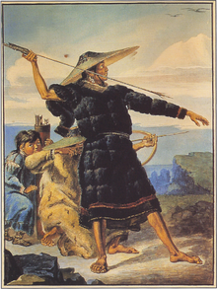
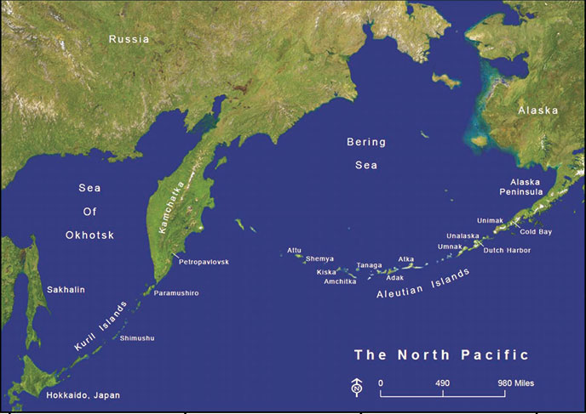
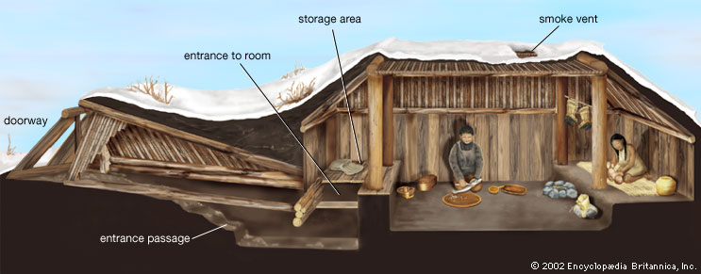
The Aleut
The Aleut people are the indigenous people of the Aleutian Islands of Alaska and Kamchatka, Russia. Presently they number 17,000 and 18,000 people. The Aleut survived by hunting and gathering. They fished for salmon, crabs, shellfish, and cod, as well as harvesting sea mammals such as seal, walrus, and whales. Caribou, musk oxen, deer, moose, and other types of game were also eaten roasted or preserved for later use.
Notes:
Mel/BreAnn

Slide 64
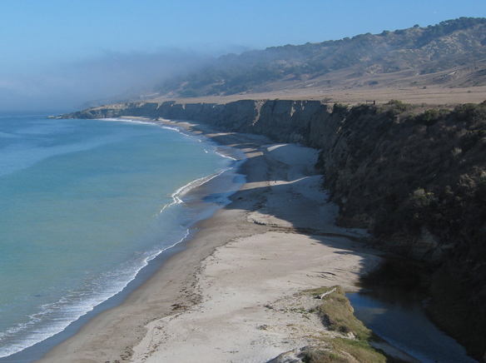
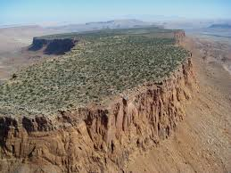
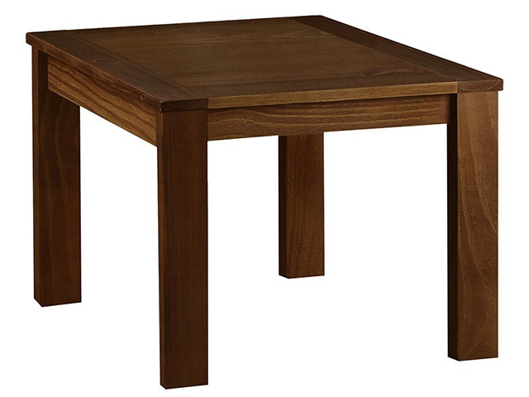
Mesa: tableland, an elevated area of land with a flat top and sides that are usually steep cliffs. It takes its name from its characteristic table-top shape.
Notes:
BreAnn

Slide 65
What is the meaning of the word sparingly in the sentence below from paragraph 1 on page 11?
“During this time the village eats sparingly, mostly from stores of seeds harvested in autumn.”
A lot
Land animals
A small amount
Mostly seeds
Notes:
Mel

Slide 66
Sample Schedule on a Typical Day
9:30-9:50- Interactive Read Aloud with presentation
9:50-10:10- Model (I Do with annotating passage)
10:10-10:30- Guided/Independent with S.S. activity and passage AND Must Do/May Do would be on the board
10:30-11:00- Article/Story of the Day
11:00-11:10- Kahoot!
11:10-11:30- Project/Writing
11:30-11:40- Closure/Data Trackers
**On days with intro lesson, Paideia, or HSI, this schedule changes. Be flexible!
Alternate Friday’s with Challenges and Read In’s!
Notes:
King

Slide 67
Resources to Use:
Pear Deck
Partners
Quizlet
Go Noodle
Data Trackers
MTSS B, Incentives
Historical Scene Investigation (HSI)
Teachers Curriculum Institute (TCI) / Social Studies Alive!
CMS Social Studies Curriculum
Notice and Note Close Reading
Paideia
Pizza Hut Book-It
Notes:
BreAnn/Mel split in half

Slide 68
Feedback
What do you want reading to look like your classroom? What could you implement to make students more engaged?
Notes:
🍐 This is a Pear Deck Text Slide
🍐 To edit the type of question, go back to the "Ask Students a Question" in the Pear Deck sidebar.

Slide 69
Questions?

Slide 70
Notes:
Auction

Slide 71
Access our presentation here!
http://bit.ly/realactiveengagement
BreAnn:
sandrab.king@cms.k12.nc.us
Melanie: melanier.kriksciun@cms.k12.nc.us
Notes:
What is something you want to use in your classroom?
What questions do you have?

