Slide 1
Using Visual Arts and Music to Envision and Collaboratively Create Poetry UNCC Teacher to Teacher April 3, 2017
Emily Lopez – Executive Director of Programs
Notes:
We will introduce ourselves and give a little overview.
1

Slide 2
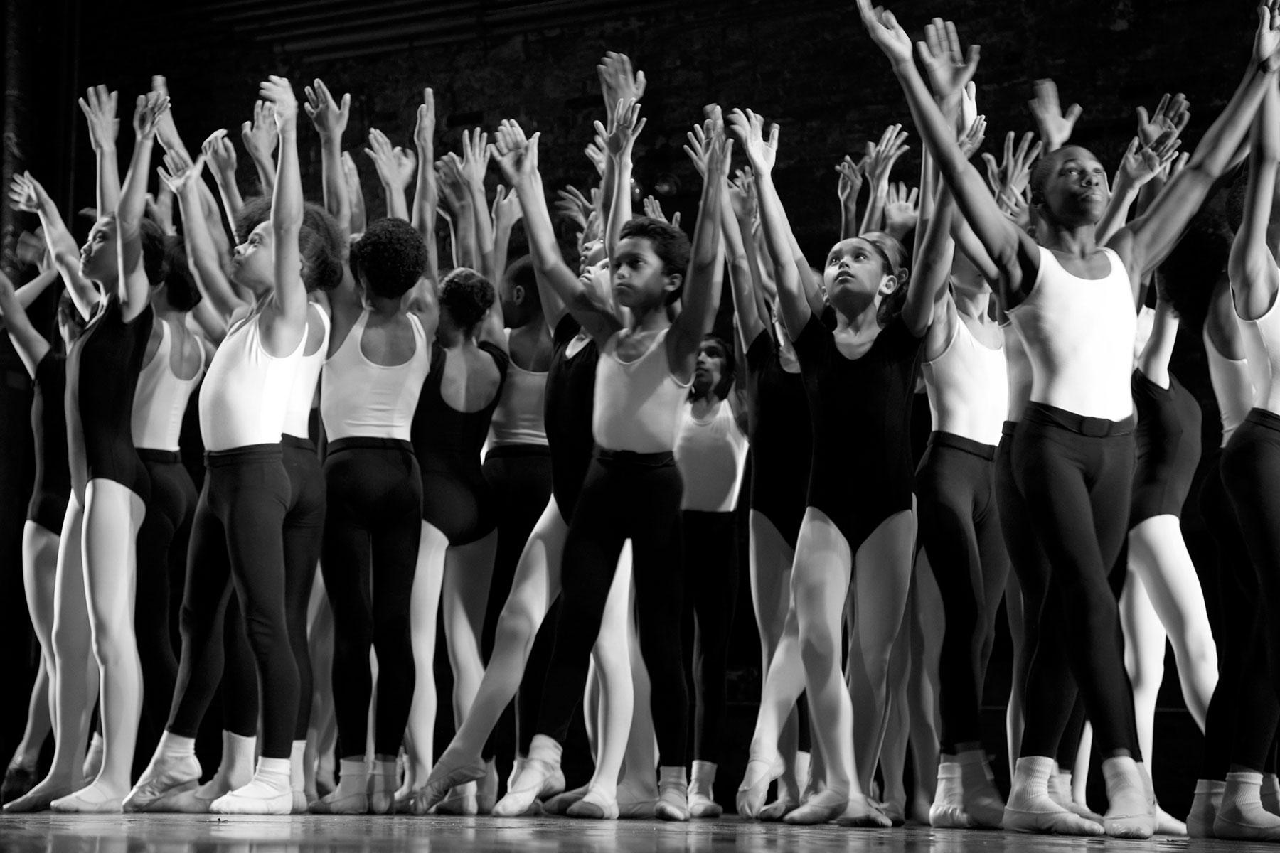
About LSG
LilySarahGrace is a teacher-led nonprofit organization, dedicated to helping all children learn, that supports educators in implementing the arts through professional development and grants for underfunded public elementary schools.
We bring the Arts & Creativity back into classrooms through a method of teaching called Arts-Infused Inquiry-Based Learning (AIIBL) that is dynamic, highly engaging and most importantly – inclusive to all learners.

Slide 3
Goals and Expectations
Goals
Participate in a collaborative approach to creating poetry that starts with music and imagery as inspiration.
Consider how to extend this experience with your students or team to engage all learners.
Expectations
Active participation
Positive attitude
Willingness to engage in a creative experience
Wear two hats (learner and student)

Slide 4
Quick Engager – Mindful Listening
Can be used to prepare our minds for a listening experience.
How else might you use this in your work?

Slide 5
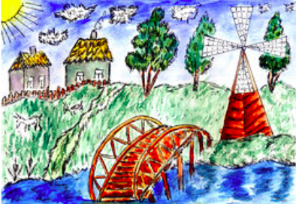
Part 1 – First Listen
Listen to the song.
While you’re listening, sketch whatever image comes to mind.
Notes:
Quick turn and talk to a partner… what did you envision

Slide 6
Part 2 – Second Listen
On your second listen, try to be attuned to nuances and details you might not have heard before.
While listening, add language – words and short phrases – to your sketch.
Notes:
Each participant writes top 5 on sentence strips or index cards. Break up into small groups of 4-6. Bring cards.

Slide 7
Combining Imagery
With your small group, arrange all of the words on your index cards to create your prose.
You must include at least two examples of figurative language.
Be prepared to share your piece with the group.
Notes:
15 mins work time and then quick share out

Slide 8
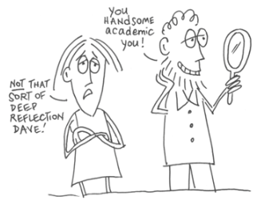
Reflecting on the Process
How did this learning experience address Common Core Standards?
What aspects of this experience are relevant to your comprehensive goals with your students?
How might you use this technique with your team?
Notes:
7 min discussion

Slide 9
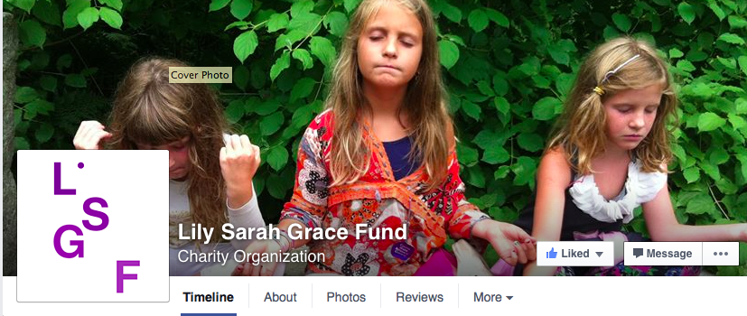
Keep in Contact
Emily Lopez – Executive Director of Programs:
Emily@lsgfund.org @emnlopez
Additional Info:
www.lilysarahgrace.org
PD@lsgfund.org
Facebook: https://www.facebook.com/LilySarahGraceFund/?fref=ts
Twitter:@LSGFUND #LSGpd

